Slide 1
Advanced Manufacturing Strategies and Technologies – The Warner Robins ALC Paradigm
Frank Zahiri
Robins AFB/WR-ALC/402 CMXG
DISTRIBUTION STATEMENT A. Approved for public release; distribution is unlimited

Slide 2
CMXG Technology Insertion - Goals
  Advanced analytics for smart manufacturing systems
    Resilient to disruptions & uncertainties
    Increased factory visibility
    Near-zero defects and downtime performance
    Worry-free production
  Industrial artificial intelligence (AI) and machine learning (ML) for smart & predictive manufacturing
    Predictive analytics for machine health monitoring, diagnosis, & prognosis
      Greater asset reliability
      Lower operating costs
DISTRIBUTION STATEMENT A. Approved for public release; distribution is unlimited

Slide 3

CMXG Advanced Manufacturing
Smart Manufacturing
IIoT Analytics
Digital Twins
Digital Manufacturing
Repair Management
Detailed Structural State
Machine Learning
Artificial Intelligence
Data Analytics
Data-driven
Multi-physics
Integration & Optimization
IIoT Platform
Digital Traceability
Industrial Connectivity
IoT-in-the-loop
Enterprise Systems of Record
AR/VR Experience
PLM
3D CAD data, BOM data, production planning, in-service data, etc.
MROi
Maintenance records, repair records, operations data, etc.
OEM
MIS, MPD, techpub, config, SB, AD, retrofits…
Failure Predictions & Monitoring Dashboards
Data Sources & Enterprise Systems
(ERP, MRP, CRM, SPDM, Etc.)
Reference:
WR-ALC/402d CMXG
DISTRIBUTION STATEMENT A. Approved for public release; distribution is unlimited

Slide 4





CMXG Digital Factory
Maintenance Order
Supplier Management
ERP
Production Plan Optimize
Process Improvement
Quality Management
Cyber World
Cyber Component
Info
Cyber Machine
Info
Cyber
Production Line
Info
Cyber Process
Info
Cyber Product
Degradation
Assessment
Health
Prognosis
Reconfigure &
Scheduling
Correlation
Analysis
Predict &
Root Cause Tracking
Data to Feature
Order Data
Machine Data
Maintenance
Record
Scheduling
Processing
Parameters
Quality Data
Supplier Data
Physical World
Quality
Check
Data
Quality
Check
Data
Quality
Check
Data
Final Quality
Inspection
Data
M1
M2
M3
M1
B1
B2
B3
M4
Delivery
M2
M3
Reference:
Prof. Jay Lee, IMS Director & Frank Zahiri
M1
DISTRIBUTION STATEMENT A. Approved for public release; distribution is unlimited

Slide 5
Smart Manufacturing Technologies
Key Enabling Technologies
Predictive Maintenance/Digital Twin Framework
DISTRIBUTION STATEMENT A. Approved for public release; distribution is unlimited
Notes:
5

Slide 6
Evolution of Maintenance Practices
From Reactive to Preemptive
Key Enabler: Prognostics!
Systematic approach to defining routine maintenance to preserve important functions
Condition-Based Maintenance
Enhanced Diagnostics
Complexity (Cost, Implementation, Infrastructure…)
Reliability Centered Maintenance
Predicting the future health of a component so that maintenance is done based on the actual material condition of the component
Repair/ Replace When Broken
Process of determining the ability of a component to perform its function
Benefits (Availability, Cost Savings, Maintenance Scheduling…)
Reference:
George J. Vachtsevanos, Ph.D.
DISTRIBUTION STATEMENT A. Approved for public release; distribution is unlimited

Slide 7
Predictive Maintenance
  Building trust, confidence, and risk mitigation in predictive maintenance
  Innovative technologies:
    Data Analytics: data mining, data pre-processing, feature extraction/detection, fusion
    Fault Diagnosis: early detection of incipient failure
    Failure Prognosis: accurate prediction of time to failure
    Predictive Maintenance: optimum maintenance strategies
DISTRIBUTION STATEMENT A. Approved for public release; distribution is unlimited

Slide 8
Asset Reliability
  Expresses percent confidence that system (asset) can execute a mission (task) over a designated period
      Reliability under stress (fault) conditions
      “One system more reliable than another”
      The method: fit the data to a suitable life distribution
      The tool: most used tool is the Weibull distribution
DISTRIBUTION STATEMENT A. Approved for public release; distribution is unlimited

Slide 9
Reliability and Life Cycle Management
  Reliability analysis tools:
    Data and data mining, data-driven modeling tools/methods
    Prognosis of remaining useful life or time to failure of failing systems/components
    First-order and higher-order reliability methods
    Optimization tools for optimum maintenance strategies
    Risk assessment and risk management or risk control methods
DISTRIBUTION STATEMENT A. Approved for public release; distribution is unlimited

Slide 10
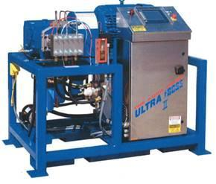
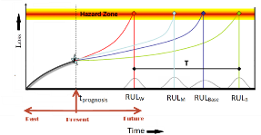

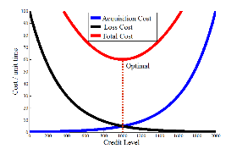
Predictive Maintenance
Reliability-Based Architecture
Engineering System
Life Aging Modeling
Life Expectancy Prognostics
Life Loss Modeling Under Stressors
Long-Term Prognosis
Life Cycle Optimization
Safety Analysis
Prognosis-Based Risk Analysis
Total Cost Optimization
Reference: Air Force Contract FA8571-20-C-0009// ALAE Solutions, LLC//
George J. Vachtsevanos, Ph.D., & Mr. Scot W. Hudson
DISTRIBUTION STATEMENT A. Approved for public release; distribution is unlimited

Slide 11
Risk Control
  Change risk profile through proactive maintenance and upgrade
  Take corrective action with acceptable risk
    Quantify risk and uncertainty
    Essential link between failure prognosis and reconfigurable control
DISTRIBUTION STATEMENT A. Approved for public release; distribution is unlimited

Slide 12
Ingredients for Success
What do I need in order to apply Predictive Maintenance technologies to my system/process?
“Data! Data! Data!”
  Sensors and Sensing Strategies
  Computing and Communications
  Modeling
  Algorithmic Developments
  The Smart Bridge Between the Real and Virtual Worlds
DISTRIBUTION STATEMENT A. Approved for public release; distribution is unlimited
Notes:
12

Slide 13
Predictive Maintenance – The Cost
“There is no free lunch”
  Sensors and sensing requirements
  Health and usage monitoring hardware/software
  Communications and computing requirements
  Modeling of physical system
  Dynamic case-based reasoning – the bridge between the physical system and its digital twin
  Putting it all together
DISTRIBUTION STATEMENT A. Approved for public release; distribution is unlimited

Slide 14
What Is a Digital Twin?
A digital twin is a virtual representation of a physical object or system across its life cycle, using real-time data to enable understanding, learning, and reasoning.
R. Rosen, G. von Wichert, G. Lo, K. D. Bettenhausen. About the Importance of Autonomy and Digital Twins for the Future of Manufacturing, IFAC-PapersOnLine, 48 (2015), 567-572
DISTRIBUTION STATEMENT A. Approved for public release; distribution is unlimited
Notes:
14

Slide 15
Digital Twin Functionalities
Improved maintenance decision making (damage prediction and reliability modelling of physical systems).
System life cycle mirroring, supporting decision making in predicting the system’s performance/behavior in the long term.
Statistically-based decision making and optimization (optimizing the system’s behavior/performance by simulating it during the design phase.
Digital twin modelling aims to assist in life cycle management of assets.
DISTRIBUTION STATEMENT A. Approved for public release; distribution is unlimited
Notes:
15

Slide 16
Key Benefits
Improve operations
Integrate asset information and history
Unify asset management processes
Extend asset life cycles
Optimize maintenance work processes
DISTRIBUTION STATEMENT A. Approved for public release; distribution is unlimited
Notes:
16

Slide 17
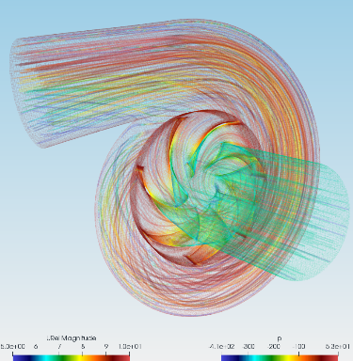
Water Pump Digital Twin
Creating a pump’s digital twin requires:
  Building its accurate 3D model and powering the model with data
Putting the digital twin into action
  The digital twin-based predictive maintenance software takes in real-time sensor records about the health and working conditions of a pump and analyzes it against historical data about the pump’s failure modes and their criticality.
DISTRIBUTION STATEMENT A. Approved for public release; distribution is unlimited
Notes:
17

Slide 18
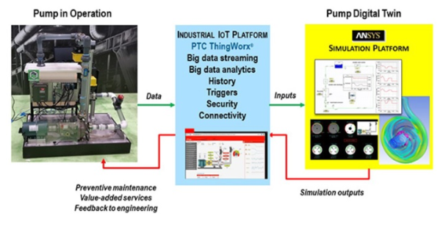
Water Pump Digital Twin Using ANSYS
Microsoft Digital Azure Twins; Other Commercial Products
Reference: Air Force Contract FA8571-20-C-0009// ALAE Solutions, LLC//
George J. Vachtsevanos, Ph.D., & Mr. Scot W. Hudson
DISTRIBUTION STATEMENT A. Approved for public release; distribution is unlimited
Notes:
18

Slide 19
Machining Centers Digital Twin
Reference: Air Force Contract FA8571-21-C-0029//Data Fusion & Neural Networks (DF&NN), LLC//
Dr. Christopher Bowman
DISTRIBUTION STATEMENT A. Approved for public release; distribution is unlimited

Slide 20
Solution Architecture for Real-Time Makino T4 Health Monitoring
Reference: Air Force Contract FA8571-21-C-0029//Data Fusion & Neural Networks (DF&NN), LLC//
Dr. Christopher Bowman
DISTRIBUTION STATEMENT A. Approved for public release; distribution is unlimited

Slide 21
AI/ML Toolbox Components and Interfaces
Known
Approved Retraining
Historical Signatures
Category &
Trust NNs
Commands
T4 &
Other Systems
Normalized
Historical POL
Trained
Approved Retraining
Category NNs
Commands
All Historical Data
TrnSatDP
Real-Time
Operational
Trained NNs
Environment
CatNet
Data
Relationship
Situation &
Observations
Response
Response
Normalization
Fusion/
Detection &
Management
Tracking
Tracking
Displays
AbNet
ClassCat
System Measurands
Abnormality
Abnormal
Countermeasures
& Retraining
New Abnormality
Fused
Detections
Classifications
Entity/Event
Relationship
“Trust” NNs
Patterns of Life
Responses
Tracks
Top blue boxes are the off-line data mining intelligent system learning normal and classes
Lower left red portions are the on-line abnormality detection and classification
Green is the Level 1 event tracking and Level 2 relationship detection and tracking
Gold is the response management and user feedback interfaces
Reference: Air Force Contract FA8571-21-C-0029//Data Fusion & Neural Networks (DF&NN), LLC//
Dr. Christopher Bowman
DISTRIBUTION STATEMENT A. Approved for public release; distribution is unlimited

Slide 22
ECAD System Benefits
AI-Driven Digital Twin Benefits
Unknown abnormal precursor detection/characterization enables reduced cost of condition-based maintenance in an evolving, automatically retrained system to meet goals.
Real-time equipment/asset health monitoring and its component health status determination through a hybrid machine-learning and model-based systems engineering approach.
Asset health monitoring and root cause identification for failures encompasses the cyber-physical domain of the equipment where the failures could be due to component related degradations and faults.
In-stride evolving automated retraining for detection of new abnormal conditions due to applying automated data and goal-driven processing.
DISTRIBUTION STATEMENT A. Approved for public release; distribution is unlimited

Slide 23
ECAD System Benefits (continued)
AI-Driven Digital Twin Benefits (continued)
Visualization of the historical events and current status of the system enables status assessment and recognition of abnormal event at any time scale.
Reduces maintenance labor costs due to reducing the number of unneeded maintenance tear down and rebuilds by detecting when maintenance is needed before a catastrophic fault.
Turnkey intelligent system reduces the number of labor hours required by experts to continually recompute the system parameter red and yellow maintenance condition test limits.
Can be utilized for designing and deploying a cyber-physical fault tolerant and resilient system since the model-based engineering approach allows determination of the critical components for system function, identifying gaps in their functional design for resilience and fault tolerance, and will suggest improvements to mitigate those design deficiencies.
DISTRIBUTION STATEMENT A. Approved for public release; distribution is unlimited

Slide 24
AI/ML Toolbox
Nondestructive inspection for defects is critical in many maintenance and overhaul operations. Analysis of data is labor intensive, time-consuming, costly, and subject to human errors.
Deep-learning algorithms, such as convolutional neural networks (CNNs), paired with imaging devices have the potential to improve efficiency and enhance inspection capabilities.
DISTRIBUTION STATEMENT A. Approved for public release; distribution is unlimited

Slide 25
Technology Solution
Automated Inspection with Deep Learning (AIDL)
  Provides automated detection and classification of surface defects for warfighter platforms, support equipment, and critical base facilities
  Leverages advanced computer vision and deep-learning techniques to extract and classify high-level features from images
    Resistance to dynamic changes in inspection environments
  Human-in-the-loop system to improve reliability and allow for continuous learning
Reference: Air Force Contract FA8571-20-P-0013//Analatom, Inc.//
Dr. Bernard C. Laskowski
DISTRIBUTION STATEMENT A. Approved for public release; distribution is unlimited

Slide 26
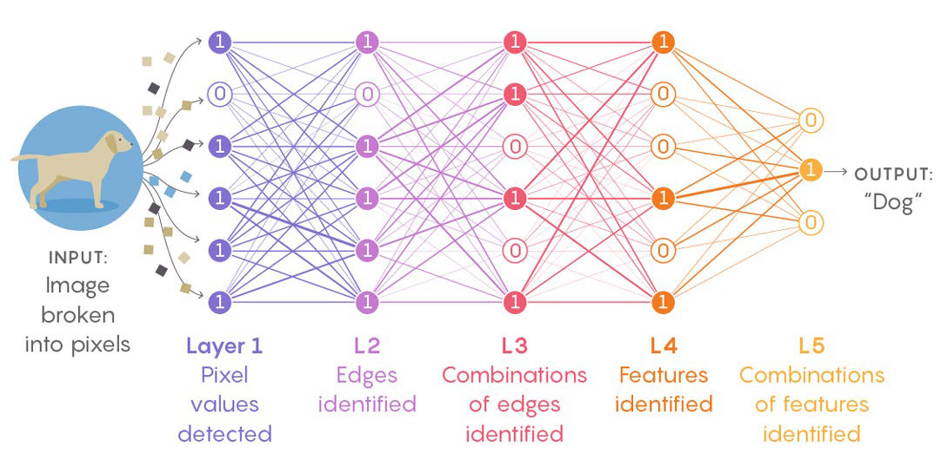

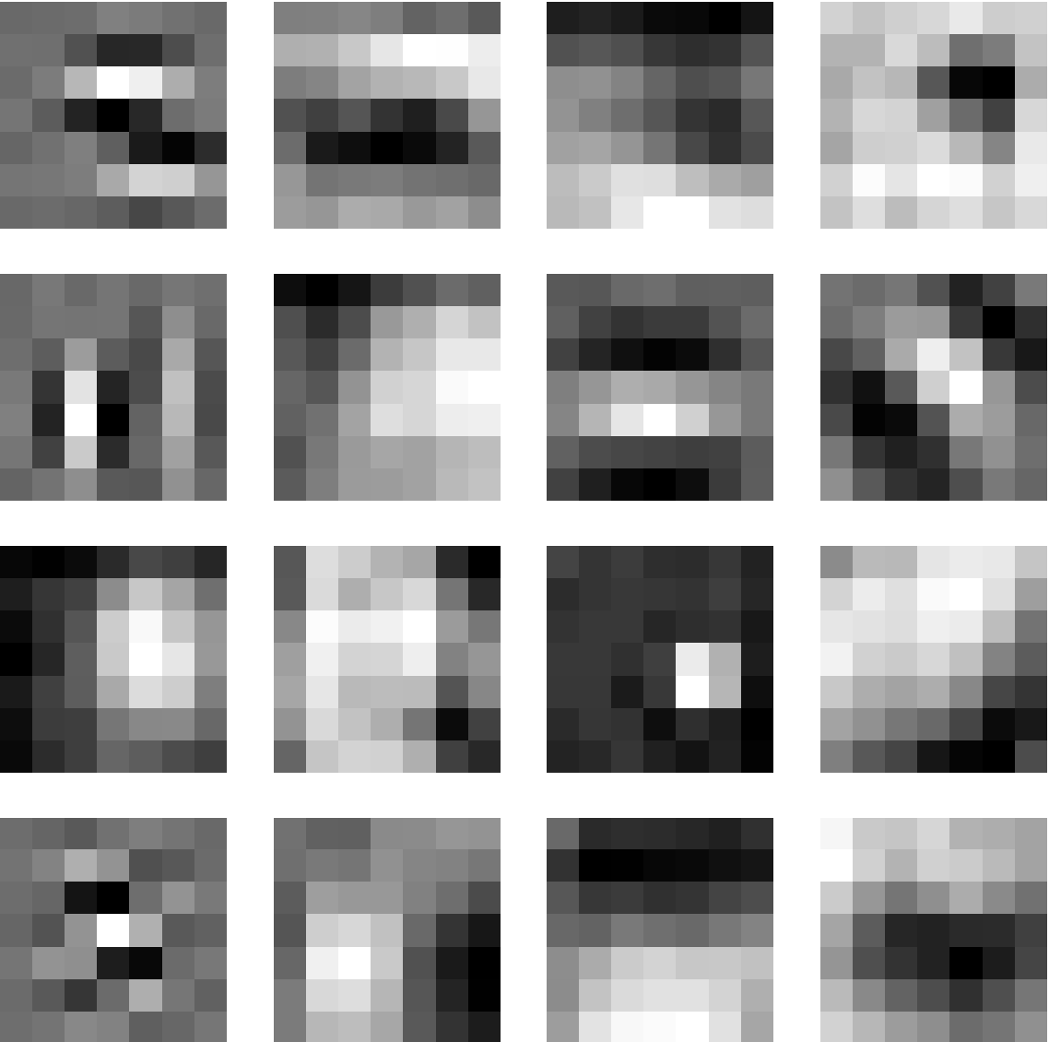


Approach
CNNs are trained to detect defects through a combination of extracted features.
  Provides rapid, accurate, and consistent inspection performance.
  Trained models can be easily applied to novel inspection tasks.
Reduces human cognitive workload by filtering images, allowing technicians to focus on more difficult, ambiguous samples.
OUTPUT:
“Corrosion”
Input image
Reconstructed image
CNN filters
Reference: Air Force Contract FA8571-20-P-0013//Analatom, Inc.//
Dr. Bernard C. Laskowski
DISTRIBUTION STATEMENT A. Approved for public release; distribution is unlimited

Slide 27
Solution Benefits
Reduction in maintenance costs.
  AIDL can provide a 75% and greater reduction in visual inspection times.
  Increased throughput and reduced costs of errors.
Improved inspection quality and consistency.
Increased flexibility and adaptability of maintenance systems.
Improved efficiency and effectiveness of users within the system.
Enhanced data collection in support of Industry 4.0 and Smart Factory initiatives.
DISTRIBUTION STATEMENT A. Approved for public release; distribution is unlimited

Slide 28
The Intelligent Digital Twin
The intelligent digital twin – incorporates a high degree of autonomy and exploits learning tools/methods to analyze granular performance, maintenance, and health data from the real counterpart.
DISTRIBUTION STATEMENT A. Approved for public release; distribution is unlimited
Notes:
28

Slide 29
AI-Driven Digital Twin Approach to Predictive Maintenance
Predictive maintenance solutions powered by digital twins help to precisely monitor equipment health and timely recognition of potential anomalies.
DISTRIBUTION STATEMENT A. Approved for public release; distribution is unlimited
Notes:
29

Slide 30
Concluding Comments
Data! Data! Data!
Seeded Fault Testing/Field Data Wherever Available
High-Fidelity System Modeling
Data Warehousing/Knowledge Bases
Prognosis – The Achilles’ Heel of CBM+/PHM
Predictive Maintenance – Optimum Maintenance Policies
Digital Twin – The New Framework for System Design/Optimization
The Expanding Customer Base: Maintainer/Manager/Designer
The Business Case: ROI
DISTRIBUTION STATEMENT A. Approved for public release; distribution is unlimited

Slide 31
Discussion/Questions
DISTRIBUTION STATEMENT A. Approved for public release; distribution is unlimited

