Slide 1

Advanced Spray-Drying
Technology for the DoD
Steve Rowley, DSIAC Webinar, April 2021

Slide 2


Contents
Spray-drying theory of operation
  Aqueous
  Solvent
  Atomization
  Particle separation
Types of spray dryers
Properties of spray-dried particles
How to upscale
Advanced spray-drying techniques
  Glass transitions
  Surface modification
  Microencapsulation
    Oils
    Probiotics/viruses
    Flavors/volatiles
  Flavor masking
  Nanoparticles/nanoencapsulation
  Instantization
Image source: Division by Zero Labs

Slide 3
Spray-Drying Theory
Atomization
Convective heat transfer
Evaporation from surface
Mass transfer of moist drying gas
Particle separation
Imagine spreading 1 cubic meter over about 16 acres!

Slide 4
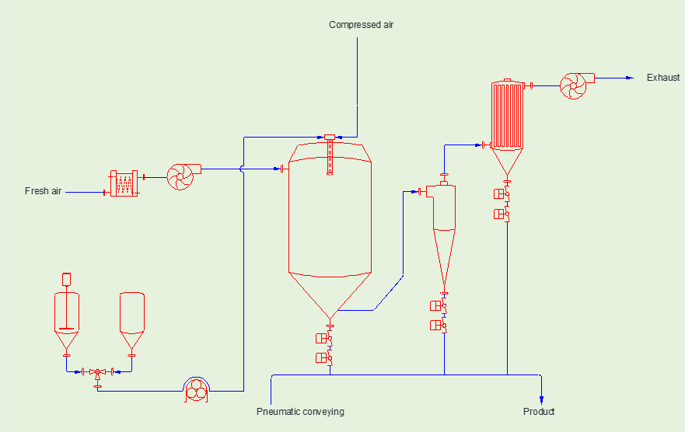
Image source: Division by Zero Labs

Slide 5
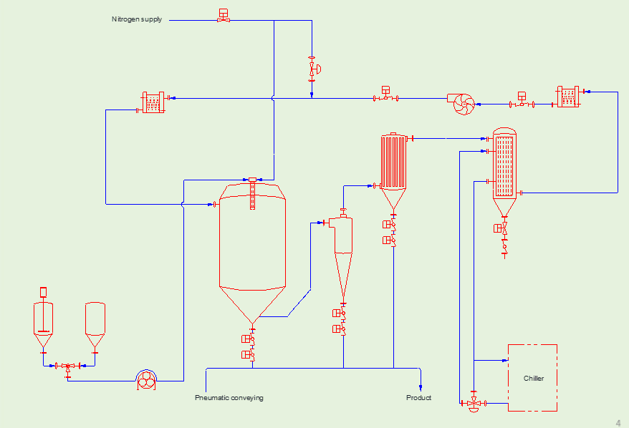
Image source: Division by Zero Labs

Slide 6
Variations in Spray-Dryer Construction
Form
  Tall form tower
  Short form tower
  Box form
  Flat bottom
Air flow configuration
  Co-current
  Counter-current
Atomization method
  Two-fluid
  Rotary
  Pressure
  Ultrasonic
  Electrostatic
Conveying method
  Pneumatic
  Screw conveyors
Notes:
Screening can be one of the most intimidating and challenging steps of the scale up process

Slide 7
Spray-Drying Theory
Evaporation ≠ Boiling
Happens on the surface
Happens when the AIR is at any temperature above the wet bulb temperature (WBT)
  WBT is affected by air saturation level
Dependent mostly on the conditions of the AIR
Happens uniformly throughout the mass
Happens when the LIQUID is at its boiling point (BP)
  BP is affected by pressure
Dependent mostly on the conditions of the liquid

Slide 8
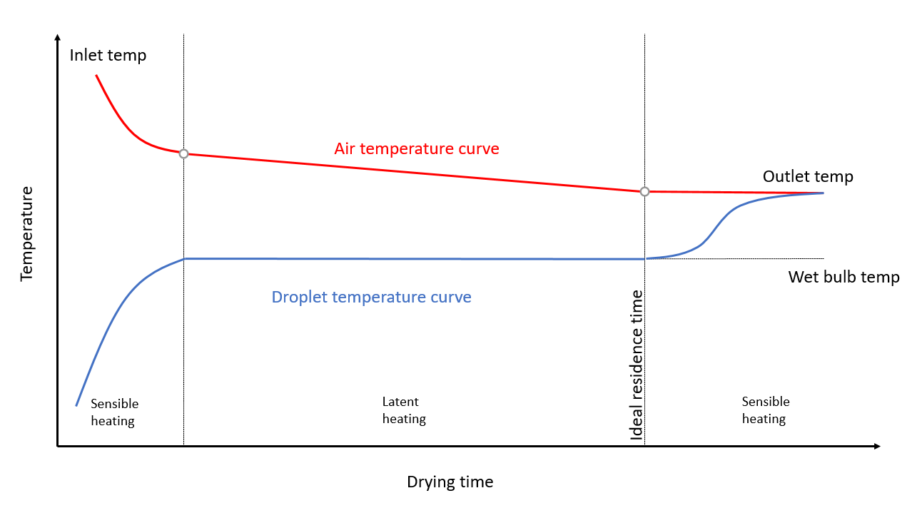
Constant evaporation rate/surface area limited
Falling evaporation rate/
diffusion limited
Image source: Division by Zero Labs

Slide 9
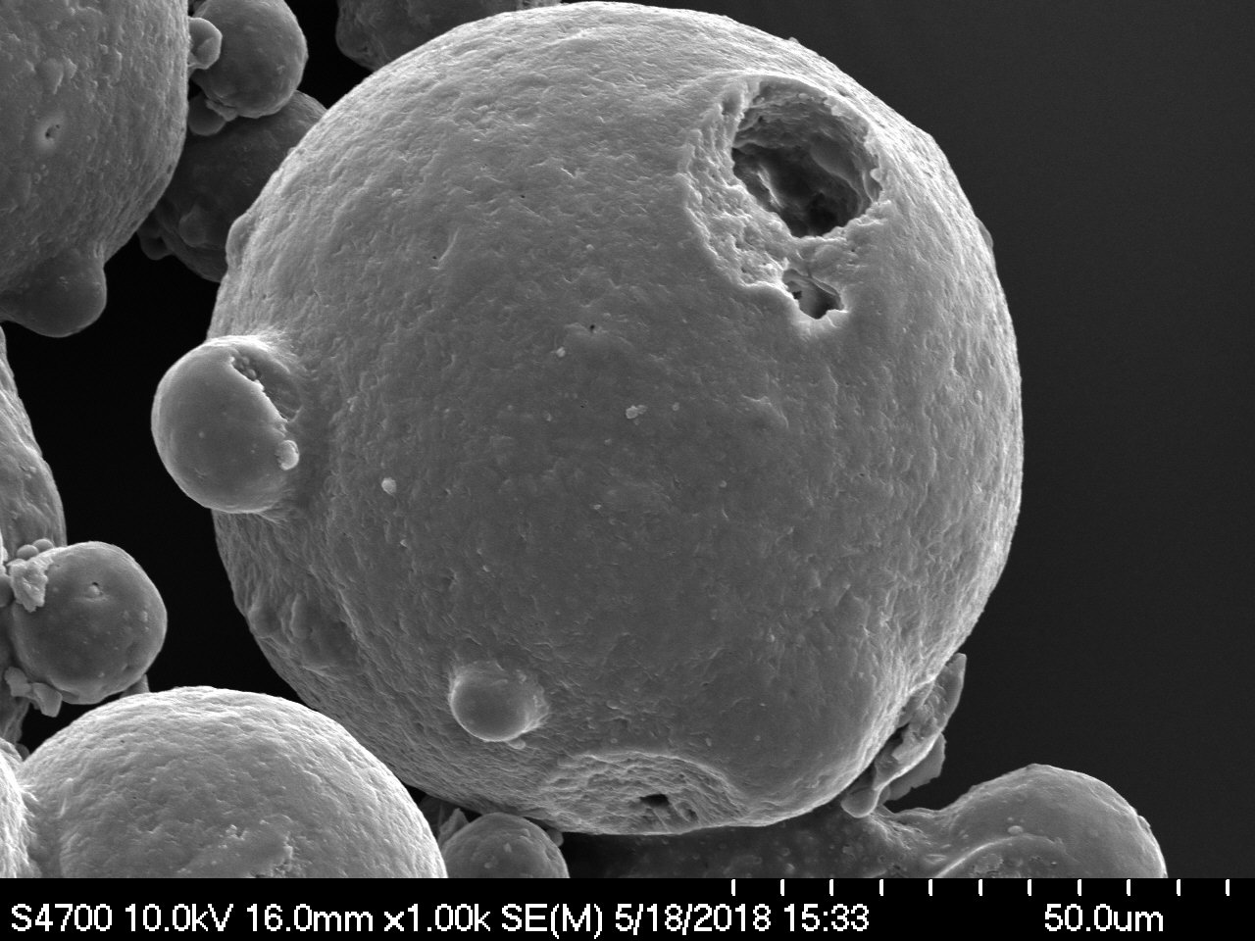
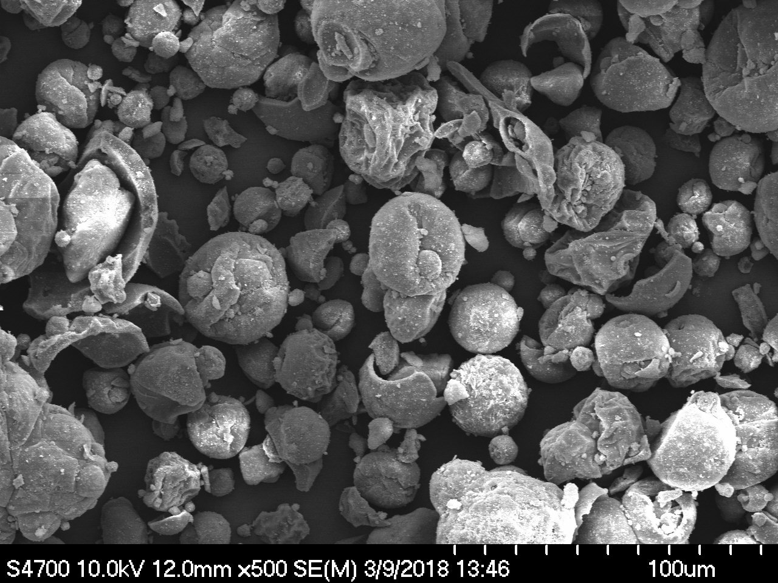
Characteristics of Spray-Dried Powders
Image source: Division by Zero Labs

Slide 10


Development and Scale-up
We don’t always realize it, but powdered materials are all around us
Developing these materials takes too much time and money
Especially when all roles are taken on by the same entity
Innovation
Process Development
Manufacturing
Identify target solution
Learn how to implement it
Run experiments
Make prototype material
Test for efficacy
Repeat
Purchase a pilot equipment
Wait for it to be built
Learn to use it
Run experiments
Design production plant
Purchase production equip
Build production facility
Staff it with experts
Run production campaigns
Pay for unused capacity
Years
Image source: Division by Zero Labs
Notes:
This is the first step towards articulating our intuition
Now we need to apply our intuition to these five characteristics of your material
To do this I like to always remember the giant cheeto!

Slide 11

Development and Scale-up Coalition Model
Originating Company/ Organization
Contract Research & Development Lab
Contract Manufacturer
Innovation
Process Development
Manufacturing
Identify target solution
Learn how to implement it
Run experiments
Make prototype material
Test for efficacy
Repeat
Purchase a pilot dryer
Wait for it to be built
Learn to use it
Run experiments
Design production plant
Purchase production dryer
Build production facility
Staff it with experts
Run production campaigns
Pay for unused capacity
Months
Image source: Division by Zero Labs

Slide 12
Product Intuition
Product intuition and experience
Properties of the feed material
Behavior of the feed material
Challenges you will likely face
Desired properties of the product
Market tolerance for changes in properties
Requires expertise in drying technologies and manufacturing
However – the key ingredients are product intuition and experience
Only the originating company/organization can provide this
Image source: Division by Zero Labs
Notes:
This is the first step towards articulating our intuition
Now we need to apply our intuition to these five characteristics of your material
To do this I like to always remember the giant cheeto!

Slide 13
Product Intuition
Product intuition and experience
Properties of the feed material
Challenges you will likely face
Properties of the product
Market tolerance for changes in properties
Behavior of the feed material
Physical form
  Solution
  Slurry
Solids content
Rheology characteristics
  Viscosity across temperatures
  Viscosity across sheer rates
Density
pH
Image source: Division by Zero Labs
Notes:
So now we are going to continue to think about the properties of our feed material but we are going to apply our intuition and try to find all the Cheetos!

Slide 14
Product Intuition
Product intuition and experience
Properties of the feed material
Behavior of the feed material
Challenges you will likely face
Properties of the product
Market tolerance for changes in properties
Temperature needs
Agitation needs
Pumpability issues
Shelf life
Intermediate storage needs
Materials compatibility
Upstream processing needs
Image source: Division by Zero Labs
Notes:
Lots of cheetos here

Slide 15
Product Intuition
Product intuition and experience
Properties of the feed material
Behavior of the feed material
Challenges you will likely face
Properties of the product
Market tolerance for changes in properties
Reactions
Handling issues
Licensing and waste
Packaging concerns
Housekeeping issues
Things the chemists complain about in the lab
have intuition
Image source: Division by Zero Labs
Notes:
With each technology we are considering we need to ask ourselves what challenges we are likely to face with our material

Slide 16
Product Intuition
Product intuition and experience
Properties of the feed material
Behavior of the feed material
Challenges you will likely face
Desired properties of the product
Market tolerance for changes in properties
Bulk density
Particle size distribution
Moisture content
Dispersability
Color
Flowability
Cohesion
Hygroscopicity
Caking
Downstream processing needs
Packaging
Image source: Division by Zero Labs

Slide 17
Product Intuition
Product intuition and experience
Properties of the feed material
Behavior of the feed material
Challenges you will likely face
Properties of the product
Market tolerance for changes in properties
Formulation cost variables
  Clean labeling
  Nutritional value
  Raw material sourcing
Conversion cost variables
  Solids content in feed
  Temperatures used
  Campaign size
  Ancillary equipment needs
  Upstream/downstream processing
  Packaging
Image source: Division by Zero Labs
Notes:
Be honest with yourself and your team about how much wiggle room you may or may not have in your product specs

Slide 18
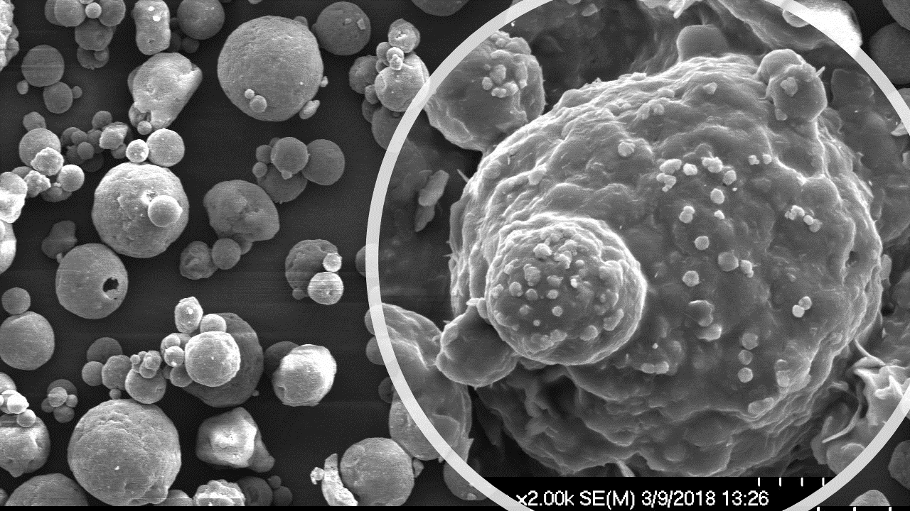
Advanced Techniques
Advanced spray-drying techniques
  Glass transitions
  Surface modification
  Microencapsulation
    Oils
    Probiotics/viruses
    Flavors/volatiles
  Flavor masking
  Nanoparticles/nanoencapsulation
  Instantization
Image source: Division by Zero Labs

Slide 19
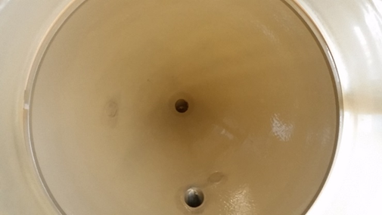
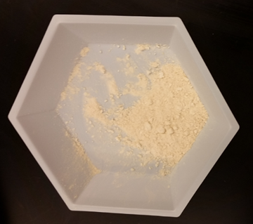
Altering Glass Transition Temperatures
Image source: Division by Zero Labs
Image source: Division by Zero Labs
Material with low glass transition temperature – sticky film
Mixed with high MW proteins or polysaccharides
Increased glass transition temperature – free-flowing powder

Slide 20
Phases of Droplet Drying and
Surface Modification
Surface evaporation and shrinkage
Solids migrate towards surface at different rates
Shell formation
Shell thickens
Hollow center forms
Hollow spherical particle

Slide 21
Oil Encapsulations
Wall materials are good film formers and dehydrate quickly
This forms a diffusion layer at the surface of the droplet
The oil must diffuse through the film as the water is evaporated
This entraps the oil
Process is known as matrix encapsulation
Wall material (large amount)
Maltodextrin
Pectin
Alginates
Pullulan
Gum arabic
Emulsion
Oil
Water
Surfactant blend
Image source: Division by Zero Labs

Slide 22
Viable Microencapsulated Probiotics
Probiotics traditionally have been preserved using lyophilization techniques requiring long cycle times, low capacities, and high cost
Spray drying solves these issues, but the process conditions can be harsh on living cells unless proper care is taken
Vitrification/thermal protectants: used in formulation development to absorb heat during the diffusion limited phase of droplet/particle drying.
  Patist, A., Zoerb, H. (2005), Colloids and Surfaces B: Biointerfaces 40(2)
  Rajam, R., Anandharamakrishnan, C. (2015), Food Science and Technology (60)
Stabilization during gel/fluid phase transitions:
  Eleutherio, E.C.A., Araujo, P., Panek, A. (1993), Cryobiology (30)
Low sheer atomization (Ultrasonic) and vacuum spray drying:
  Semyonov, D., Ramon, O., Shimoni, E. (2011), Food Science and Technology 44
Added benefits of microencapsulation include:
  Oxygen diffusion barriers: protect the cells from oxidative stress during high air-flow, convective-drying processes
  Wall materials with pH dependent stability: ideal wall materials will be stable in low pH conditions (stomach) but will rapidly degrade at neutral or basic pH conditions (large intestine) to release probiotics at the active site

Slide 23
Microencapsulated Flavors/Volatiles
Volatiles have been preserved in microencapsulated flavors
Rosenberg, M. Sheu, T.-Y. (1996), International Dairy Journals (6)
This is possible because of the selective diffusion that occurs during the constant the drying step
Good microencapsulation formulation technique is required
Temperature plays an important role – lower temperatures will help preserve volatiles
Special atomization technology can help facilitate the use of lower temperatures
  Electrostatic atomization

Slide 24
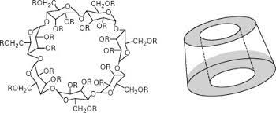
Flavor Masking
Three basic strategies
  Covering flavors with stronger flavors
  Blocking receptors with “interference” molecules
  “Cloaking” molecules with cyclodextrins
Image source: Comprehensive Supramolecular Chemistry II, 2017, 269-316, A. Hashidzume, Y. Takashima, H. Yamaguchi, A. Harda

Slide 25
Nanoparticles
Spray dryers can be used to produce nanoparticles
Requires special atomization technology
  Piezoelectric driven, vibrating mesh
Requires special particle recovery technology
  Electrostatic precipitation
  Has been difficult to scale thus far
Image source: Division by Zero Labs – adapted from Buchi.com

Slide 26
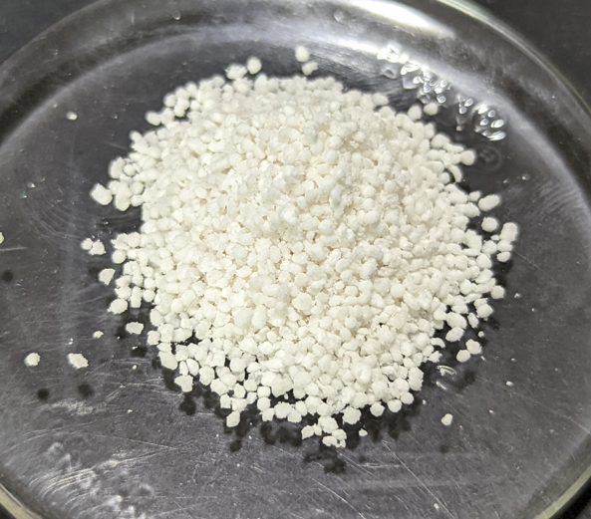
Fluid Bed Agglomeration
Water bridge
Fluidized powder
Warm air
Evaporation and shrinkage
Agglomerate
Binder spray
Image source: Division by Zero Labs

Slide 27
Questions?

